Slide 1
Test methods in Android Studio
Tim Steven Meier

Slide 2
Structure
Testing Pyramid
Local Unit Tests
Instrumented Unit Tests
Automating UI Tests
Espresso
UI Automator Testframework
Sources

Slide 3
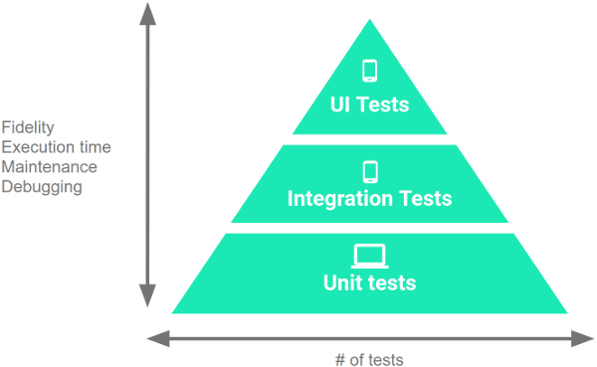
Testing Pyramid
Small Tests (~70%)
Unit tests in IDE
Fast and focused
Medium Tests(~20%)
Integration tests
Run on emulators or real devices
Testing different Hardware
Large Tests(~10%)
UI tests
Testing the whole workflow

Slide 4
Local Unit Tests
Similar to Java Unit tests
No Android framework dependencies
@SmallTest Annotation instead of @Test
Create a test with pressing Crtl+Shift+T in the class you want to test
Android Studio creates a test class with generated methods or fields

Slide 5
Instrumented Unit Tests
Physical devices and emulators
Take advantage of the Android framework APIs
Looks if widgets exist

Slide 6
Automating UI Tests
Manual testing of UI is too time-consuming
Testing UI for single App with Espresso
Intra App Actions
Testing specific Actions
Testing UI for Multiple Apps with the UI Automator
Cross App Performance
e.g. test if the camera shares images with the App

Slide 7
Espresso
Testing framework for UI Tests
Generating tests by interact with the emulator and recording it
Test will be generated afterwards and is still edible

Slide 8
UI Automator Testframework
Key Features:
A viewer to inspect the layout hierarchy
Api to retrieve state informations from the device
Api to perform Operations on the device
APIs that support cross-app testing

Slide 9
Sources
https://developer.android.com/training/testing/index.html
https://developer.android.com/studio/test/index.html

